Slide 1

Hip-hop
李明达、余成竹

Slide 2
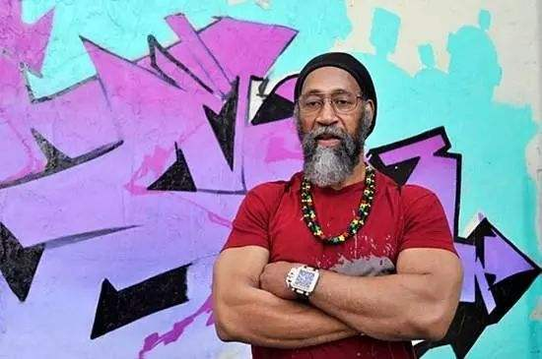
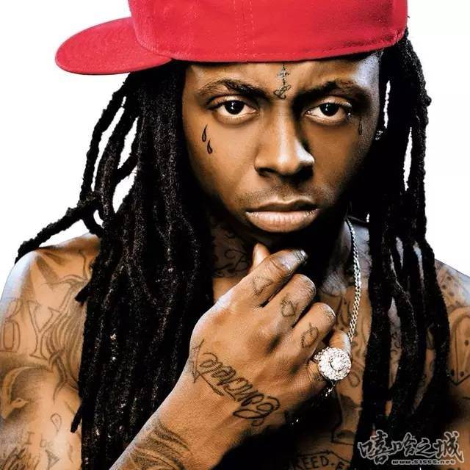
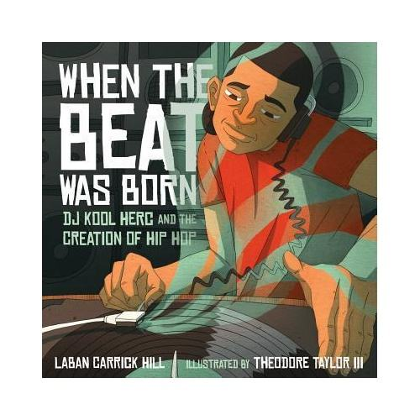
The origin of hip-hop
Hip-hop music originated in the 1960s in downtown Bronx, New York City, USA. At a party, DJ Kool Herc created a unique use of two phonographs to repeat the wonderful breaks in the same album, keeping the party atmosphere at the climax. And some young people began to dance or sing along with the accompaniment, which led to the early street dance (B-boy) and rap (MC).

Slide 3
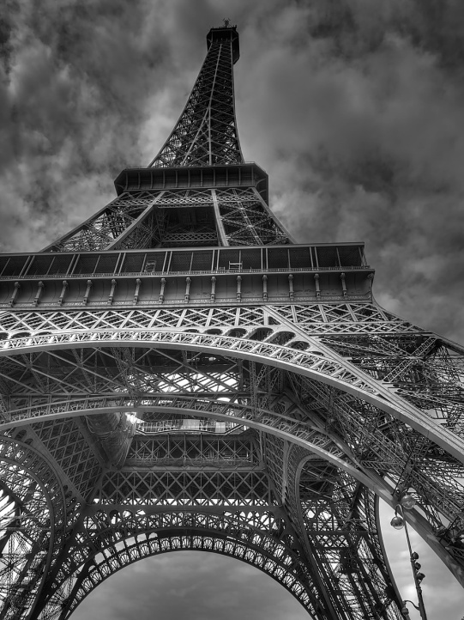
Freestyle
Freestyle is the improvised rap.
Freestyle battle——
After the development of gangs, it has become a way to replace bloody conflicts and resolve disputes.

Slide 4
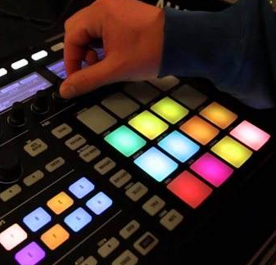
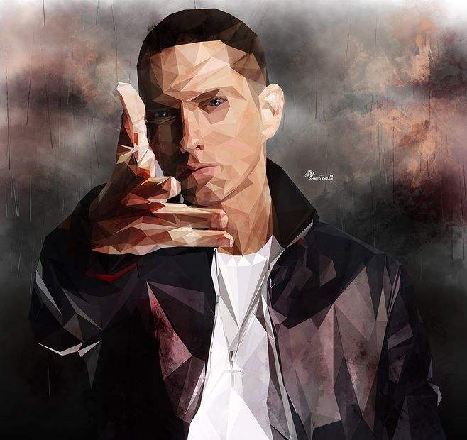

The three cores of rap
01
02
03
Arranging（编曲）
Rhyme（韵脚）
Flow(说唱技巧)
Arranging is beat
Rap discards the melody in music and replaces it with the rhythm——Flow

Slide 5
Classification of rap
Lyrics content
Area
Arranging style
Gangsta rap（匪帮说唱），Comedy rap（喜剧说唱）, etc.
East Coast Hip Hop
West Coast Hip Hop
Southern Hip Hop, etc.
Trap、Boombap、Hardcore, etc

Slide 6
THANKS

